Slide 1

DATE
Oscar
Pinks
Citizenship 9

Slide 2
TABLE OF CONTENTS
TABLE OF CONTENTS
WHERE
1
2
3
4
Personal
Community
Global
Aspirational

Slide 3
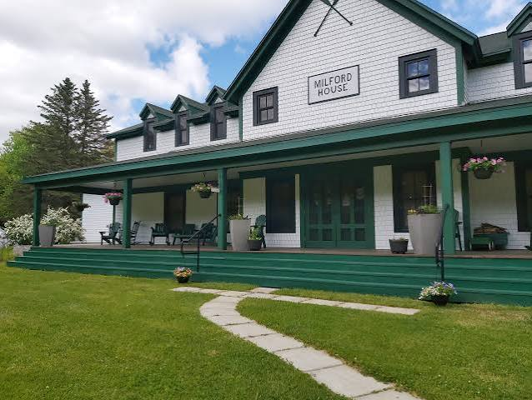
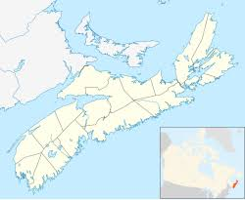
The Personal Place
Cit 9 WHERE
MAP SCREENSHOT (from Bing Maps) | Reflection: This place is called Milford House. Since I was 3 years old my family, every summer drove roughly 2-3 hours, rented a cottage on a lake, and stayed there for up to a week. We would spend the days fishing and swimming, and the nights around a fire playing cards. They would serve 3 meals a day, and I would always get seafood chowder, which is very good. Guiding Questions: Not far from the cottages, is where the previous owners used to live. They were very kind and would always give gifts to me and my sister, mostly stuffed animals. They were very kind and would always help employ people in need. | IMAGE
Notes:
The Personal Place
Reflection: Write a paragraph about a personal place that holds significance for you.
Guiding Questions:: In a second section, describe how your personal perspective shapes the way you see and feel about this place. What stories or memories are tied to this specific location?

Slide 4
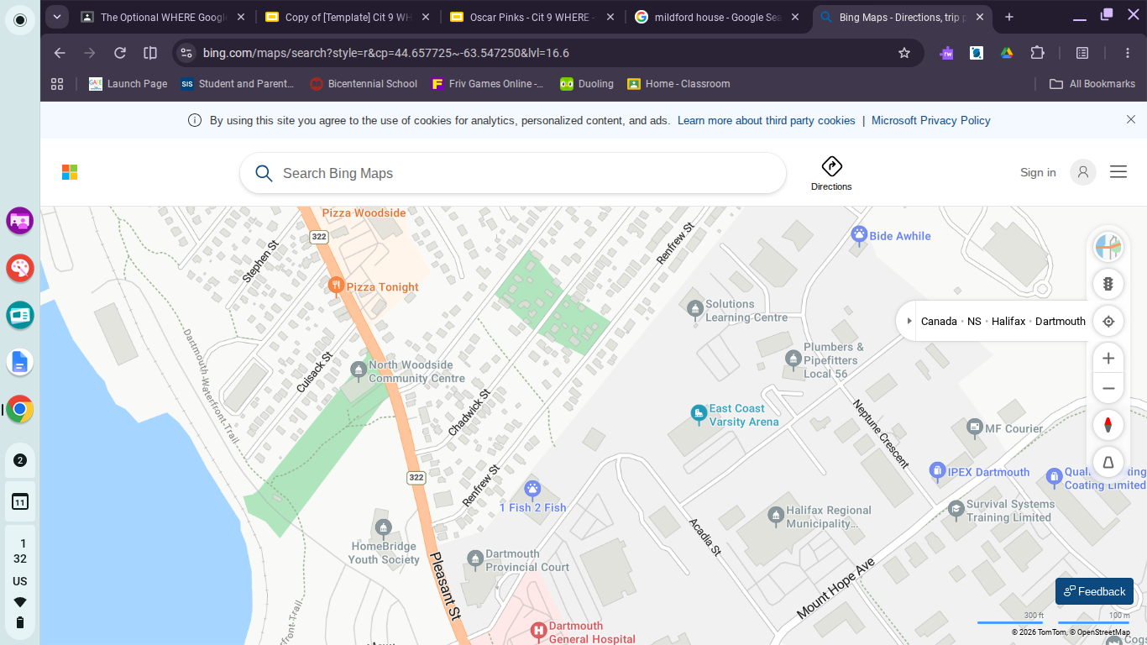
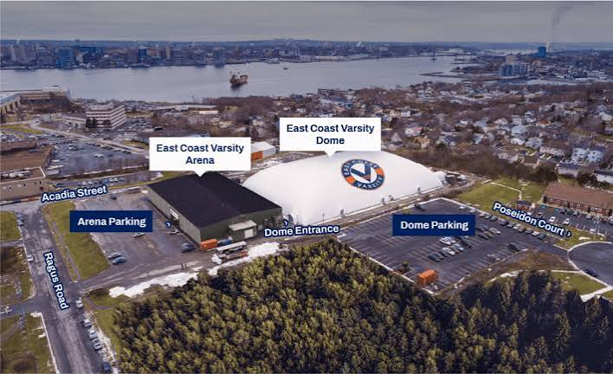
The Community Place
Cit 9 WHERE
MAP SCREENSHOT | Reflection: The place i chose is East Coast Varsity. It is a sports dome of which people play soccer, football, lacrosse, and baseball. I chose this place because it is where i spent years learning the sport i love. Year after year, no matter the time, I always end up there. | IMAGE
Notes:
Reflection: Write about a significant place in our local community. Tell the story of the place! Who owns it? Why do you like it? Describe something that happened there that you remember.

Slide 5
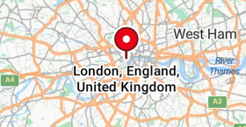

The Global Place
Cit 9 WHERE
MAP SCREENSHOT | Reflection: The place I chose is england. I chose england because I have family in Brighton, and my family immigrated from London. My grandfather and grandmother, had flown to Canada from London England, started a new life, and have lived on to love canada. My cousins are from brighton England. Every couple of years we fly out and live with my cousins for a week or two and it’s always really fun. | IMAGE
Notes:
Reflection: Write a story about a place in the world that is part of your family's story.
Guiding Questions: Tell the story of how you and/or your family are connected to this place.
What traditions or values from this place have been passed down to you?
How does this connect to your cultural identity, including things you do and who you are?

Slide 6
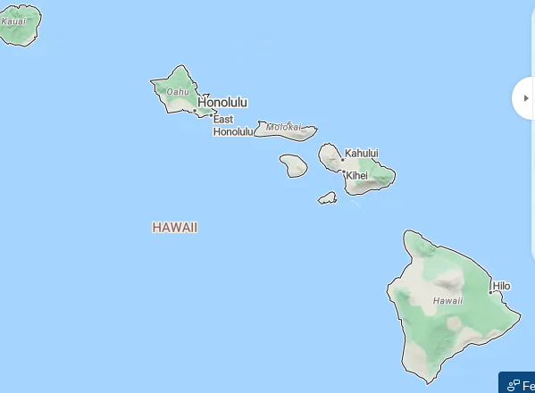
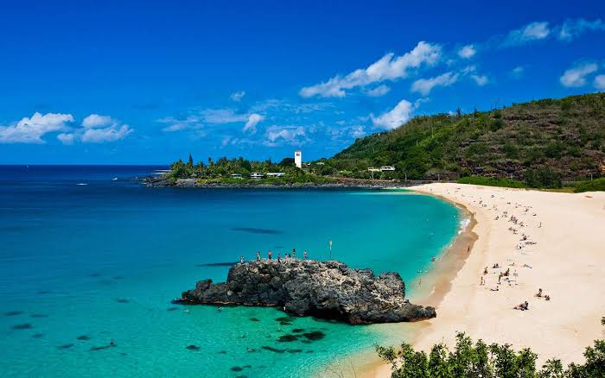
The Aspirational Place
Cit 9 WHERE
MAP SCREENSHOT | Reflection: I’ve always wanted to go to Hawaii. The main reasons I’ve wanted to go is because of the beaches. I hear the water is perfectly clear. I think it would be a great time to get a beach resort and spend the days playing in the water. | IMAGE
Notes:
Reflection: Write a story about a place in the world that is part of your family's story.
Guiding Questions: What draws you to this place? What do you hope to learn or experience there? How does this place fit into your hopes for the future?

Slide 7
The Aspirational Place
Cit 9 WHERE
Soundtrack of your life The song I choose is country roads, by John Denver. | Post the youtube link here https://www.youtube.com/watch?v=uu7j_xljCRY | What’s the story on the song? Write here! Every time I hear this song I think of camping at Rissers beach. When I was 5 my parents took me camping and we listened to this song all the way there. Every time I hear this song I think about that camping trip. We played cards, threw a ball and had a great time
Notes:
Reflection: Write a story about a place in the world that is part of your family's story.
Guiding Questions: What draws you to this place? What do you hope to learn or experience there? How does this place fit into your hopes for the future?

Slide 8
THANK YOU

